Slide 1
Sleep Disorders
By
Muvea

Slide 2
What is sleep?
An altered state in which people become relatively unaware of external stimulation

Slide 3
What Happens When We Sleep?
Sleep occurs in a recurring cycle of 90 to 110 minutes and is divided into two categories:
Non-REM and REM sleep.
There are four stages in the non-REM sleep.

Slide 4
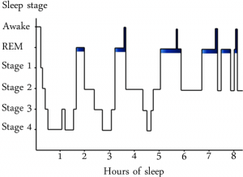
Sleep Cycle
Roughly 5 periods of REM sleep per night
  Sleep becomes lighter as night wears on
  REM sleep becomes longer towards MORNING

Slide 5
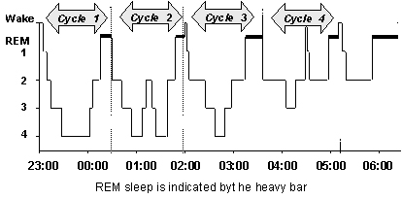
Normal Sleep Pattern

Slide 6
Sleep Stages
Wake
2/3 of life
NREM Sleep
~80% of night
REM Sleep
~20% of night

Slide 7
Stage 1 - Rapid Eye Movement) (Non-REM)
Non-REM
  Breathing slows down
  Disengage from sensation

Slide 8
Stage 2 Non-REM
Non-REM
  Small muscle twitches
  Breathing rhythmical

Slide 9
Stage 3 Non-REM
Non-REM
  Slow wave sleep
  Probably a transition stage

Slide 10
Stage 4 Non-REM
Non-REM
  Oblivious to outside world
  Sleep-walking, sleep-talking occur here
  Very difficult to wake up- but can have activities
    Answer the phone, talk, etc…
Then…you ascend back up through these stages and enter your 1st dream

Slide 11
REM (Rapid Eye Movement)
Body functions during REM
  Brain neurons fire more
  Increased blood pressure
  Increased respiration
  Increased heart-rate
  Body is paralyzed…
Nightmares occur now = frightening, unpleasant dreams
No sleep walking during REM

Slide 12
Circadian Rhythm
Circadian Rhythm
  Internally generated sleep/wake cycle connected to 24-hour period of earth’s rotation

Slide 13
Normal Sleep Values
Normal sleep per day is between 6-8 hours, although some people can maintain a 4-6 hour cycle
4-6 NREM/REM cycles per night
Sleep structure changes throughout life

Slide 14
Why Do We Sleep?
Recuperative Theory: Conserves energy, restores body tissues depleted during daily activity
  REM: hormones released that influence thinking & memory formation, mental organization; counteract fatigue, irritability, inattention
  NREM: body replenishes itself (tissue restoration and release of growth hormone)

Slide 15
What if I Miss Sleep?
Effects On Brain
  Moodiness
  Decreased cognitive performance
    Learn slower, remember less, loss concentration & creativity
  Blurred vision
  Disorganized speech
  Hallucinations
Effects On Body
  Immune system weakens
  Metabolic malfunction
  Varied body temp

Slide 16
Sleep Disorders

Slide 17
Important facts
Sleep disorders are common
Sleep disorders are serious
Sleep disorders are treatable
Sleep disorders are under diagnosed

Slide 18
Classification of Sleep Disorders
Sleep disorders are categorized into 10 disorders or disorder groups:
  (1) Insomnia disorder
  Hypersomnolence disorder
  Narcolepsy
  (4) Breathing-related sleep disorders
  (5) Circadian rhythm sleep–wake disorders
  (6) Non-rapid eye movement (NREM) sleep arousal disorder
  (7) Nightmare disorder
  (8) Rapid eye movement (REM) sleep behavior disorder
  (9) Restless legs syndrome
  (10) Substance-/medication-induced sleep disorder

Slide 19
Disorders of Inadequate/Excessive Sleep
Insomnia disorder
Hypersomnolence
Narcolepsy
  Much less prevalent in the general population
  Commonly comorbid with affective and other types of psychopathology

Slide 20
Sleep Disorder Criteria
For all sleep disorders:
  Sleep disturbance (or associated daytime fatigue) causes clinically significant distress or impairment in social, occupational, or other important areas of functioning
  Do not occur exclusively during the course of another mental disorder (e.g., depression, posttraumatic stress disorder) and are not due to the direct physiological effects of a substance (e.g., drug of abuse, medication) or a general medical condition

Slide 21
Insomnia Disorder

Slide 22
Insomnia Disorder
Predominant complaint of dissatisfaction with sleep quantity or quality, associated with:
  Difficulty initiating sleep
  Difficulty maintaining sleep (frequent awakenings)
  Early-morning awakening with inability to return to sleep
  Insomnia is a symptom – not a disease per se

Slide 23
Insomnia Disorder Cont.
At least 3 nights per week; for at least 3 months
Despite adequate opportunity for sleep

Slide 24
Insomnia Disorder cont.
Insomnia is the most prevalent of all sleep disorders in the general population and in those who are seeking treatment from primary care or mental health professionals
20% prevalence rate in general population

Slide 25
Insomnia Disorder cont.
More prevalent in women and older patients
Commonly a comorbid condition with a medical or psychiatric disorder
50% meet criteria for mental health diagnosis, usually anxiety or depression

Slide 26
Causes of Insomnia
Insomnia is a downstream symptom of an upstream problem, for example:
  Medical
  Psychological/ Psychiatric
  Behavioral
  Parasomnias
  Drug-induced
  Combination of factors in chronic insomnia

Slide 27
3 P’s of Acute Insomnia
Predisposition
  Anxiety, depression, etc.
Precipitation
  Sudden change in life
Perpetuation
  Poor sleep hygiene

Slide 28
Acute Insomnia
Resolves with the management of inciting factors
  More common in women and those with anxiety

Slide 29
Acute Insomnia Cont.
Jet Lag
  Symptoms last longer with eastbound travel
  Remits spontaneously in 2-3 days
  More common in the elderly

Slide 30
Management of insomnia
Good Sleep History
Rule out primary psychiatric disorders
Rule out adverse effects of medications
Sleep Diary
Good Sleep Hygiene Measures
Interventions – CB Therapy, medications

Slide 31
Management of insomnia Cont.
Treat underlying causes whenever possible
Advise patient to avoid exercise, heavy meals, alcohol, or conflict situations just before bed
Plain aspirin or paracetamol in low doses may be helpful; or give short-acting hypnotics or a sedative
Treat underlying depression

Slide 32
Management of insomnia Cont.
Treat underlying Medical Condition
Treat underlying Psychiatric Condition
Improve sleep hygiene
Change environment
CBT: ‘primary insomnias’, transient insomnia
Pharmacological
…

Slide 33
Hypersomnolence

Slide 34
Hypersomnolence
Self-reported excessive sleepiness despite a main sleep period lasting at least 7 hours and at least one of the following:
  Recurrent sleep periods within the same day
  More than 9 hours of sleep that is nonrestorative
  Difficulty being fully awake after abrupt awakening

Slide 35
Cont.
At least 3 nights per week; for at least 3 months
The somnolence does not occur exclusively during the course of narcolepsy, breathing-related sleep disorder, circadian rhythm sleep disorder, or a parasomnia

Slide 36
Cont.
5% to 10% of patients who seek treatment for excessive daytime sleepiness suffer from hypersomnolence disorder
Estimated to affect 1% of the general populations

Slide 37
Cont.
Males and females are equally affected
Onset is often progressive with mean age of onset between 15 and 25 years of age

Slide 38
Consequences of Excessive Sleepiness
Greater risk of accidents (vehicular, industrial, or household)
Increased absenteeism, reduced work productivity, poor academic performance .
Mood disorder (depression or irritability)
Impaired interpersonal relationships.

Slide 39
Common causes of excessive sleepiness
1-Inadequate sleep duration
2-Frequent awakenings and fragmented sleep
3-Pathology of the CNS sleep-wake apparatus
Narcolepsy
Post-traumatic hypersomnia
Recurrent hypersomnia
Kleine-Levin syndrome
Menstrual-related hypersomnia
4- Disturbance of the circadian rhythm sleep ***
***

Slide 40
Narcolepsy

Slide 41
Narcolepsy
Narcolepsy: Definition - A disorder due to a malfunction of the sleep/wake cycle regulating system in the brain, caused by the lack of an important chemical in the part of the brain responsible for controlling sleep

Slide 42
Narcolepsy
Recurrent periods of irrepressible need to sleep, lapsing into sleep, or napping occurring within the same day, occurring at least three times per week over the past 3 months
The presence of one of the following:
  - Episodes of cataplexy, defined as
    Sudden bilateral loss of muscle tone with maintained consciousness that are precipitated by laughter or joking
  - Hypocretin deficiency, as measured using cerebrospinal fluid (CSF)

Slide 43
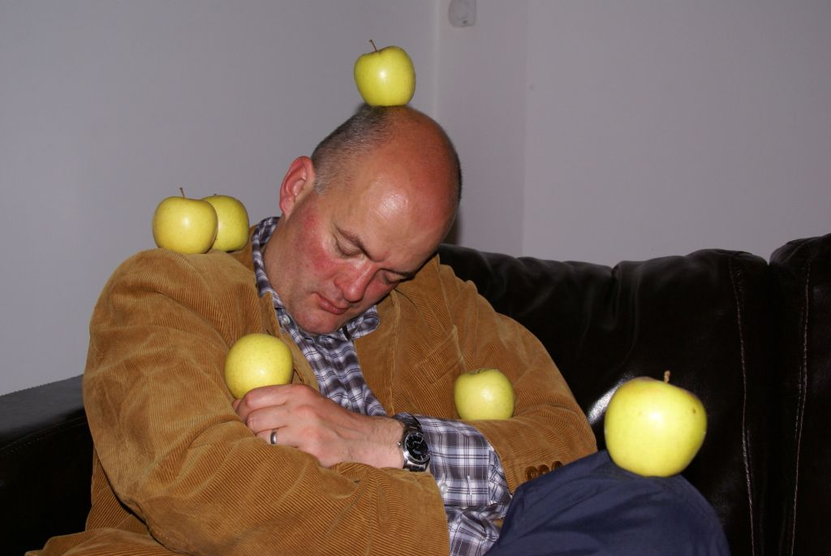

Slide 44
Narcolepsy Cont.
Prevalence of classic narcolepsy with emotion-triggered cataplexy is approximately .02% to .05%
Equal incidence in men and women
Approximately 30% of narcoleptics suffer from excessive daytime sleepiness
Approximately 20% report sleep paralysis upon falling asleep or awakening

Slide 45
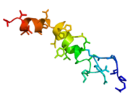
Causes of Narcolepsy
-People with narcolepsy have a reduced numbers of protein producing neurons that control appetite and sleep patterns
-These proteins are called hypocretin or orexin
A depiction of the neuropeptide Orexin A. People with narcolepsy often have a reduced number of neurons that produce this protein.

Slide 46
Symptoms
Symptoms
- Excessive sleepiness
- Temporary decrease or loss of muscle control (Cataplexy)
- Vivid dream like images
- Unable to move or talk while asleep (
Sleep paralysis )
Prevalence
- Has been calculated to be 0.03%
- Can occur during anytime in life
- Mostly affects teens
- Has been found to be hereditary

Slide 47
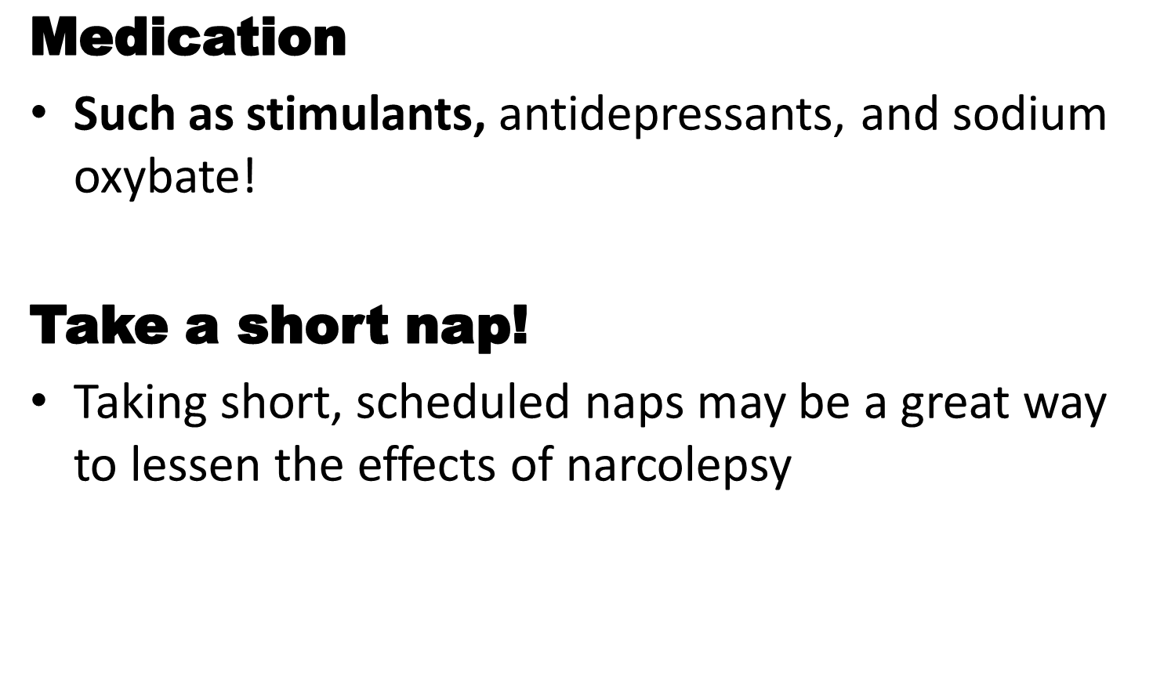
Treatment of Narcolepsy!

Slide 48
Nightmare Disorder

Slide 49
Nightmare Disorder
Repeated occurrences of extended, extremely dysphoric, and well-remembered dreams that usually involve efforts to avoid threats to survival, security, or physical integrity
Occurs almost exclusively during REM sleep and thus more likely to occur during the second half of the sleep period
On awakening, individual rapidly becomes oriented and alert

Slide 50
Cont.
Nightmares are fairly common in childhood
About 6% of adults have one nightmare per week
Only 1% to 2% have more frequent nightmares
Peak ages are 10 to 29 for women; 30 to 49 for men
Highly associated with PTSD
May produce clinically significant insomnia

Slide 51
Non-REM Sleep Arousal Disorders

Slide 52
Non-REM Sleep Arousal Disorders
Repeated occurrence of incomplete arousals from non-REM sleep; usually occurring during the first third of the nighttime sleep episode; typically brief (10 minutes – 1 hour), accompanied by one of the following:

Slide 53
Non-REM Sleep Arousal Disorders Cont.
  Sleepwalking: Repeated episodes of rising from bed during sleep and walking about; while sleepwalking, the person has a blank, staring face, is relatively unresponsive to the communication efforts of others to communicate, and can be awakened only with great difficulty
  Sleep terrors: Recurrent episodes of abrupt terror arousals from sleep, usually beginning with a panicky scream; intense fear and autonomic arousal is present (tachycardia, rapid breathing, sweating); relatively unresponsive to efforts of others to comfort
Little or no dream image is recalled
Amnesia for the episode is present

Slide 54
Non-REM Sleep Arousal Disorders Cont.
10% to 30% of children have at least one sleepwalking episode and 2% sleepwalk often
Prevalence is lower in adults (1–7%)
Sleep terrors more common in children
20% young children, with 4% to 5% experiencing one or more episodes per week
75% of patients with sleep terrors will report sleepwalking

Slide 55
REM Sleep Behavior Disorder

Slide 56
REM Sleep Behavior Disorder
Repeated episodes of arousal during sleep associated with vocalization and/or complex motor behaviors
Behaviors arise during REM sleep and therefore usually occur more than 90 minutes after sleep onset; more frequent during the later portions of the sleep period; uncommon during daytime naps

Slide 57
REM Sleep Behavior Disorder Cont.
Upon awakening from the episode, the individual is completely awake, alert, and not confused or disoriented
Either of the following:
  REM sleep without atonia
  History suggestive of REM sleep behavior disorder and an established condition (e.g., Parkinson’s disease)

Slide 58
REM Sleep Behavior Disorder Cont.
Usually appears in adulthood
Men over age 50 most likely to be affected
When diagnosis is made earlier, 1:1 gender
Best prevalence estimate is 0.5% in general population
Often able to recall dream content
Usually noticed when it causes danger to the patient
Comorbid narcolepsy occurs in approximately 30% of cases

Slide 59
Etiological Considerations
REM sleep behavior disorder may present years before medical disorders (Parkinson’s disease)
Lesions or dysfunction in REM sleep and motor control circuitry in the pontomedullary structures is hypothesized to explain REM sleep behavior disorder years or decades before the onset of neurogenerative disease

Slide 60
Restless Leg Syndrome

Slide 61
Restless Leg Syndrome
Symptoms: Creeping or crawling sensations that make the legs uncomfortable unless they are moving.
Prevalence: Millions of people are affected by RLS.
Definition: A sleep disorder characterized by leg discomfort during sleep, which is only relieved by frequent movements of the legs.
Causes: In most patients, the cause is unknown. However, RLS has been linked to pregnancy, obesity, smoking, and anemia

Slide 62
Circadian Rhythm Sleep Disorders

Slide 63
Shift Work Sleep Disorder (SWSD)
Symptoms are excessive sleepiness, insomnia, difficulty concentrating, headaches, and lack of energy.
Prevalence are people who may frequently rotate shifts or work at night.
Treatments are being put on medication, and try not to get your work shifted if possible.

Slide 64
Jet Lag
Symptoms are fatigue, insomnia, anxiety, constipation, diarrhea, confusion, dehydration, headaches, irritability, nausea, sweating, coordination problems, and memory loss.
Prevalence: affects most people who fly that cross five or more time zones. Severity increases with number of zones they travel through.
Treatments are to be put on medication.

Slide 65
Sleep Apnea and Snoring

Slide 66
Sleep Apnea and Snoring
Definitions
Sleep Apnea is when someone temporary stops breathing in their sleep.
Snoring is a rattling noise made by someone when they are sleeping usually from the back of their mouth or noise
Causes
Sleep apnea is caused lack of enough air getting to the lungs. This could be because the person has a cold or allergies.
Also the position of the tongue can cause snoring.

Slide 67
Treatments
Nasal strips or spray
Sleep on side
Elevate head 4-6 inches

Slide 68
SYMPTOMS AND PREVALENCE
-When airway is blocked, soft tissue in the throat collapses and closes while asleep
-Irritable, lack of sleep, soar throat, emotional issues, morning headaches, loss of energy, loud snoring, daytime sleepiness possibly while driving
-approximately 1 in 15 people in the general population
-more likely for men than women

Slide 69
Substance-Induced Sleep Disorder (Indicate Substance)

Slide 70
Substance-Induced Sleep Disorder (Indicate Substance) Cont.
Characteristics
  Evidence must be present that the sleep disturbance is a direct physiological consequence of substance use.
  Substance use that produces a sleep disorder severe enough to warrant independent clinical attention
Alcohol; Amphetamine; Caffeine; Cocaine; Opioid; Sedative, Hypnotic, or Anxiolytic; Other (or unknown) Substance

Slide 71
Substance-Induced Sleep Disorder Cont.
Types:
Insomnia Type
Hypersomnia Type
Parasomnia Type
Mixed Type
Specify if:
With Onset During Intoxication
With Onset During Withdrawal
…

Slide 72
Thank You

